Slide 1
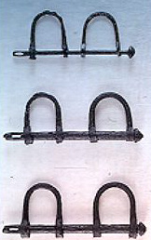
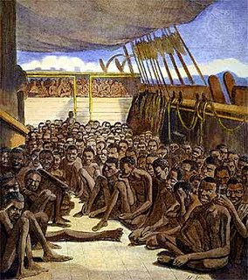
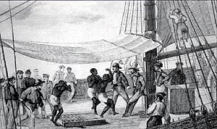

Slide 2
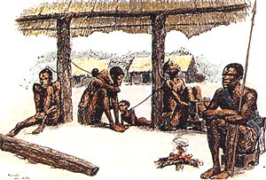
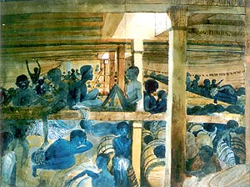
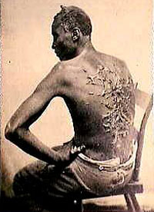
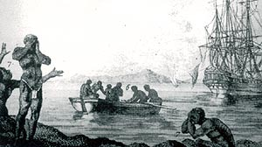
Africans lament the loss of their fellow countrymen.
Notes:
Europeans had their palettes sweetened by American sugar and chocolate, their nervous system stimulated by American tobacco, and their bodies clothed with American cotton, but at a tremendous cost to humanity. The death rate from the brutal treatment of slaves was high, and we can only imagine the magnitude of human suffering caused by a system that uprooted people from their homeland, often separated them from their loved ones, and forced them into hard labor for the rest of their lives.

Slide 3
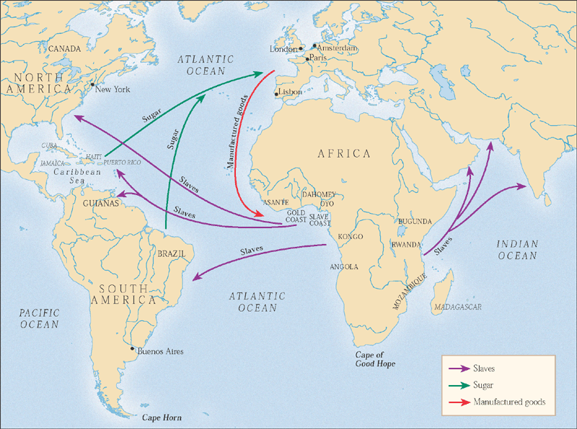
MAP 26.2 The Atlantic slave trade, 1500-1800.

Slide 4
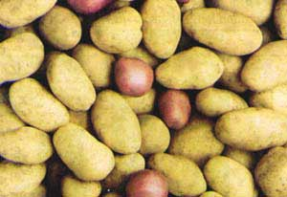
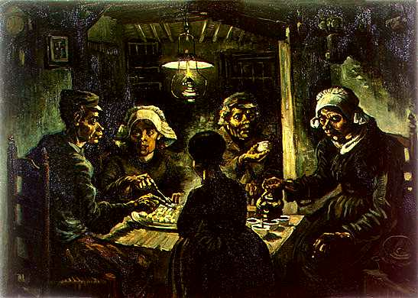
The Potato
The potato grows well in the temperate climate of northern Europe and produces three times as much food per unit of land as wheat or any other grain.
The Poor Person’s Food
Notes:
The Potato Eaters ►
The Old World was just as dramatically transformed by the introduction of American food plants. In the centuries after Columbus, the number of Europeans in relation to the rest of the world increased dramatically. Although there are many reasons for this, one important one was the increase in food production due to the gradual adoption of New World crops. In particular, the potato – which became known as the poor person’s food – was largely responsible for a dramatic increase in the population of Northern Europe. Wheat could only be grown in Northern Europe during a short summer season, and a bad harvest often caused starvation. The potato, on the other hand, grows well in the temperate climate of northern Europe and produces three times as much food per unit of land as wheat or any other grain.
The causes of the Industrial Revolution in Europe are many, but it is hard to imagine it from ever occurring without the increase in population and agricultural productivity made possible by the Columbian Exchange.
[Likewise, it is hard to imagine the growth of world trade that followed the discovery of the Americas and eventually fueled European industrialization without the capital obtained in the form of gold and silver mined in the New World.]

Slide 5
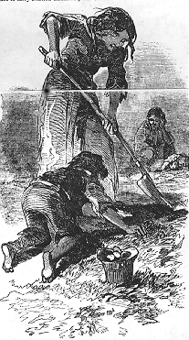
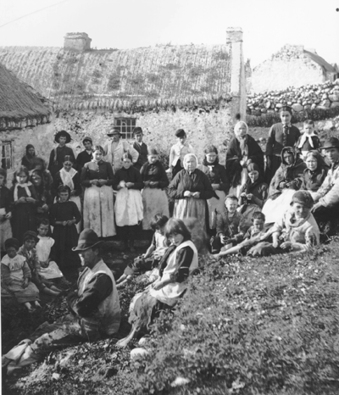
Between 1781 and 1845, the Irish population doubled from four to eight million. Probably half of this population depended on the potato for survival.
Notes:
The effects of adapting new crops was not uniformly positive, however. The poor Irish peasant, evicted from the best lands by English landlords, discovered like many poor northern Europeans that they could cultivate potatoes successfully on tiny plots of land using only primitive farming tools. Since only an acre or two of potatoes was sufficient to feed a family, Irish men and women married earlier than elsewhere and started having children earlier as well. This led to significant growth in population. Between 1781 and 1845, the Irish population doubled from four to eight million. Probably half of this population depended on the potato for survival.

Slide 6
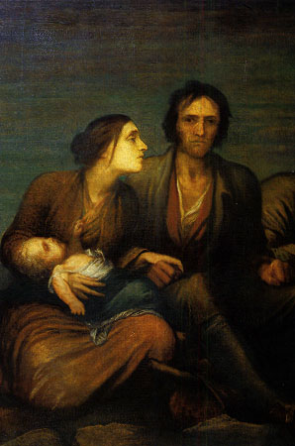
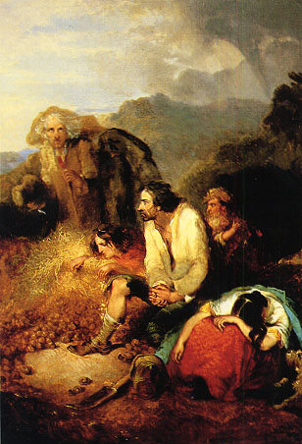
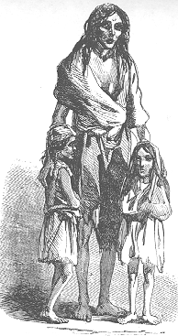
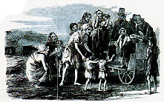
The Great Irish Famine Over one million died of starvation and disease, and almost two million emigrated to the United States and Britain.
Notes:
In the summer of 1845, the potato crop in Ireland was struck by a blight from a fungus that turned the potatoes black.
Over the next six years a famine (known as the Great Irish Potato Famine) decimated the Irish population. Over one million died of starvation and disease, and almost two million emigrated to the United States and Britain.

Slide 7
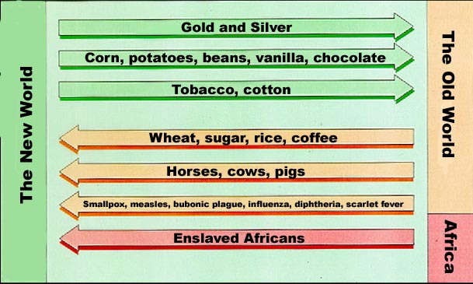
The Columbian Exchange
Notes:
In sum, the Columbian Exchange dramatically transformed the world by connecting various ecosystems. One result of this was that the world’s ecosystems became more intermixed, causing some species of plants and animals to die out while enabling other to expand into new areas and increase in number.
The most important consequences of the Exchange were demographic: the depopulation of Native Americans in the New World because of disease and the growth of the Old World population via the introduction of new foods.
The effects of the Columbian Exchange are still with us today. Our diets are more diverse, products from all over the world can be found in most general stores, and we are even more exposed to different cultures. Just as sailing ships brought smallpox out of isolation during the 16th century, jet planes today quickly spread diseases from continent to continent. People all over the world today have more diseases in common, more foods in common, and even more fashions in common than every before. Aids has spread world-wide; so too had Mac Donalds and Levi jeans. What's happening today is just what we've been doing for hundreds of years. Bit by bit by bit, we are becoming more homogenized.
So what do you think of this? Is this a good thing? What can the history of the Columbian Exchange teach us about facing the challenges of an increasingly uniformed world?
Please think about such questions and be prepared to discuss them in our next class session.

Slide 8
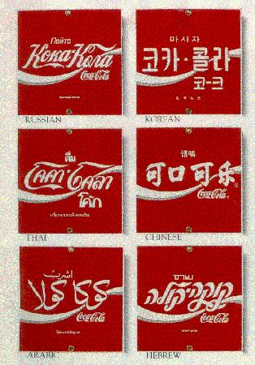
The effects of the columbian exchange are still with us today.
Bit by bit, we are becoming more homogenized,
and the world is becoming smaller.
Notes:
The effects of the Columbian Exchange are still with us today. Our diets are more diverse, products from all over the world can be found in most general stores, and we are even more exposed to different cultures. Just as sailing ships brought smallpox out of isolation during the 16th century, jet planes today quickly spread diseases from continent to continent. People all over the world today have more diseases in common, more foods in common, and even more fashions in common than every before. Aids has spread world-wide; so too had Mac Donalds and Levi jeans. What's happening today is just what we've been doing for hundreds of years. Bit by bit by bit, we are becoming more homogenized.
So what do you think of this? Is this a good thing? What can the history of the Columbian Exchange teach us about facing the challenges of an increasingly uniformed world?

