Slide 1
Amended Class Policy
LEARN
Yessenia Chacon

Slide 2
L- Listen to Instructions

Slide 3
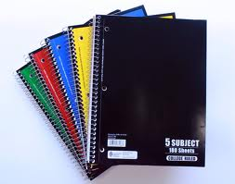

E-Enter and Exit Prepared
2 of each (pencils sharpened.)
B4B-Before the Bell
-Read the board
  -Have your supplies out
  -Including sharpening or trading pencils

Slide 4

A-Always Try Your Best

Slide 5
R-Respect Yourself and Others
http://www.youtube.com/watch?v=iGuT9-_Y5J4

Slide 6



N-No Excuses!

Slide 7





Class Policies
L- Listen to instructions.
E-Enter and exit prepared.
A-Always try your best.
R-Respect yourself and others.
N-No Excuses!

Slide 8
Other Classroom Policies

Slide 9
Entrance and Dismissal Policy
Enter the classroom and get ready for class.
Dismissal- To be dismissed the class must be clean and you must be seated in your seat. You will be dismissed by groups.

Slide 10

High Five
Drop what you are doing and listen.

Slide 11
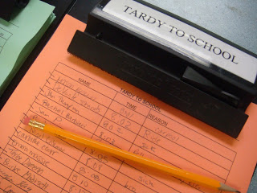

Tardy Policies
Tardy Sign-in when you walk in.
Drop passes in the bin.

Slide 12

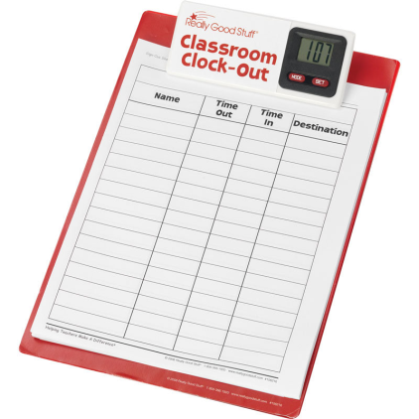
Hallway Passes
Ask permission
Sign out and Sign in
Take appropriate pass
You shouldn’t be out for more than 5 minutes.

Slide 13
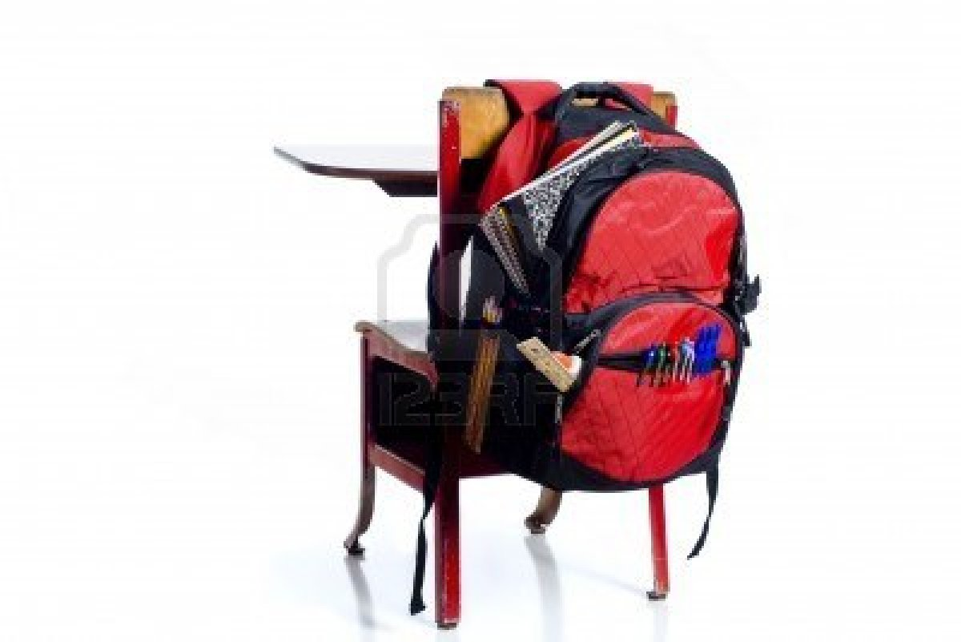
Book Bags
Under your seats or the back of your chair.

Slide 14

Cell Phone Policy
All cell phones should be put away unless the teacher has given you permission to use them for educational purposes.

Slide 15
Electronic Policy
Ipads and laptops will be assigned to your group.
1&2 of each group has the device (1,2,3,4,5,6)
3&4 of each group has the device (1A,2A,3A,4A,5A,6A)
Check the device for any defects and report it at the beginning of class.
Gently connect all devices after class.

